Slide 1
Habit Impact Simulator
CAUSE and EFFECT

Slide 2
Introduction
This project is a habit-based productivity simulation system. It checks how daily habits affect student productivity, focus, and mental performance.
The system takes user habits like:
Study hours
Sleep
Screen time
Exercise
Reading
Outdoor activity
Then it calculates a Productivity Score.

Slide 3
Problem Statement
Most students do not realize how their habits affect their performance.
Examples:
Less sleep → low focus
More screen time → distraction
Less exercise → low energy
So this system converts habits into a measurable score.

Slide 4
Objective of the System
The main objectives are:
Analyze daily habits
Measure productivity
Give improvement suggestions
Help students maintain balance

Slide 5
Input Variables (Habits)/ Independent Variables
The system takes these inputs:
Study Hours
Sleep Hours
Screen Time
Outdoor Activity
Reading Time
Exercise Time
Dependent variable : Productivity Score

Slide 6
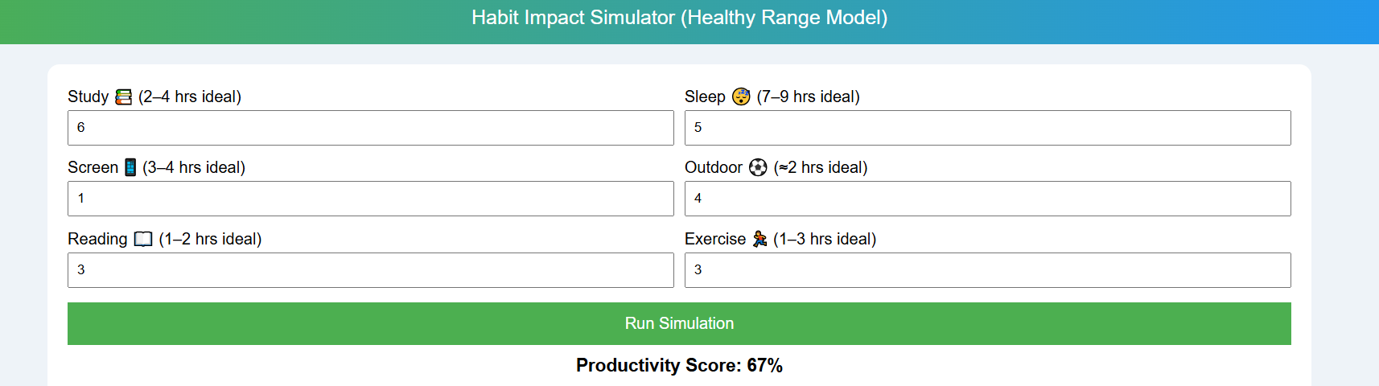

Slide 7
Cause-and-Effect Logic
Positive Habits:
Study ↑ → Productivity ↑
Sleep ↑ → Focus ↑
Exercise ↑ → Brain Performance ↑
Negative Habit:
Screen Time ↑ → Attention ↓

Slide 8
How System Persuades Students
The system persuades students by:
Showing visual productivity score
Giving real-time feedback
Explaining bad habits
Encouraging balanced routine

Slide 9

Productivity Formula
System uses Weighted Sum Model (MCDA).
$Score=\left(Study×15\right)+SleepScore+\left(Outdoor×10\right)+\left(Reading×10\right)+\left(Exercise×10\right)−\left(Screen×6\right)$

Slide 10
Improvement Analysis
System gives suggestions like:
Sleep 7–9 hours
Reduce screen time
Increase exercise
Increase outdoor activity

Slide 11
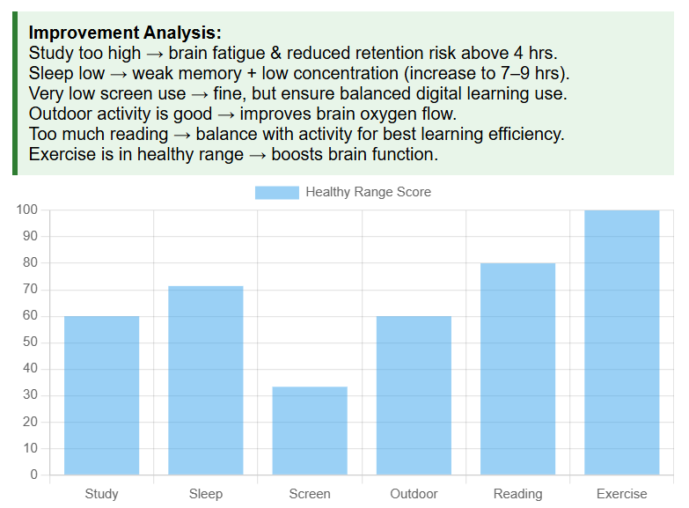

Slide 12
References
Use references from your document:
Chatgpt
CDC Sleep Guidelines
WHO Exercise Guidelines
NIH Reading Benefits
MCDA
Weighted Sum Model

Slide 13
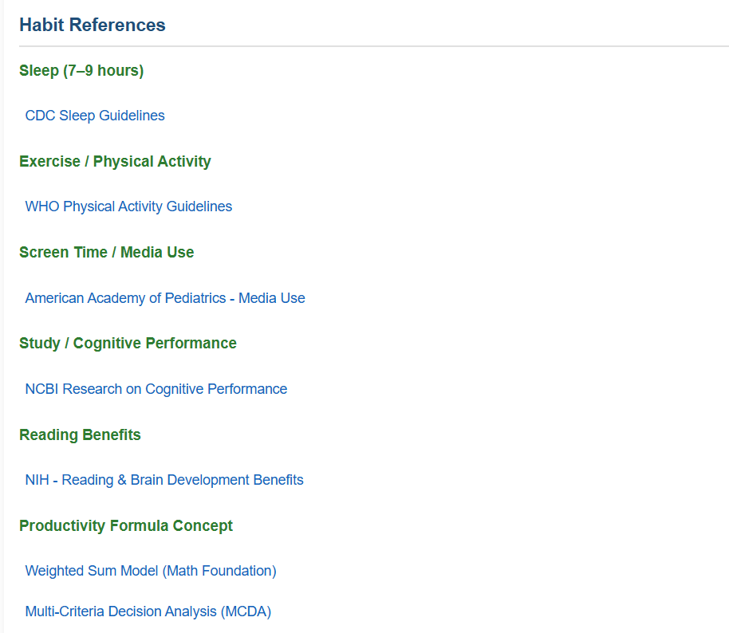
Reference link provided:

